Slide 1
Software Design for Cloud 2
Python Programming
Lecture 4
GUis

Slide 2

Hello World - GUI
from tkinter import *
label = Label(None, text="Hello World") # create widget
label.pack() # place on screen
label.mainloop() # starts process

Slide 3

2 Labels
from tkinter import *
label = Label(None, text="Hello World") # create widget
label.pack() # place on screen
label2 = Label(None, text="Second Label") # create widget
label2.pack()
mainloop()

Slide 4
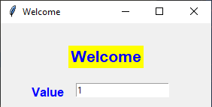
First Application
from tkinter import *
window = Tk()
window.geometry("300x300")
window.title("Welcome")
label1 = Label(window, text="Welcome", fg="blue",bg="yellow", font=("arial", 16, "bold"))
label1.place(x=90, y=30) # place on screen
label2 = Label(window, text="Value", fg="blue", width=10, font=("arial", 12, "bold"))
label2.place(x=10, y=80)
entry2 = Entry(window)
entry2.insert(END, '1')
entry2.place(x=100, y=80)
mainloop()

Slide 5
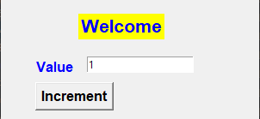
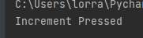
Now Add Button
:
def incr():
print("Increment Pressed")
:
:
entry2.insert(END, '1')
entry2.place(x=100, y=80)
button1 = Button(window, text="Increment", fg="black", font=("arial", 12, "bold"),
command=incr)
button1.place(x=40, y=110)
mainloop()

Slide 6
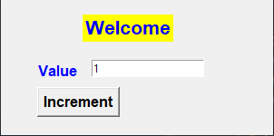
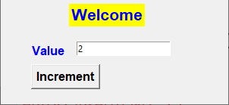

Now Event handling
from tkinter import *
window = Tk()
window.geometry("300x300")
window.title("Welcome")
def incr():
value = int(entry2.get()) # read value
value = value + 1 # step value
entry2.delete(0, END) # delete old value
entry2.insert(END, value) # insert new value

Slide 7
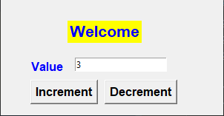
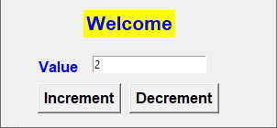

Ex41 (use EX41_skel.py)
Add a decrement button that steps value down by 1

Slide 8
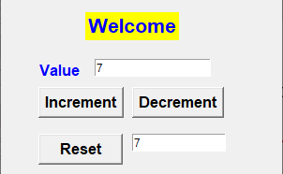
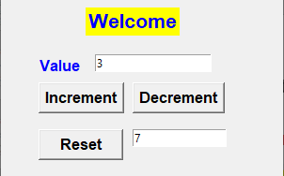
Ex42 (use EX42_skel.py)
Add a reset button and a text field
Allows user to reset the value

Slide 9
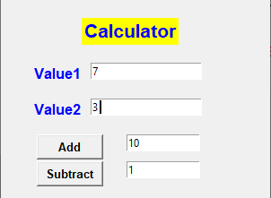
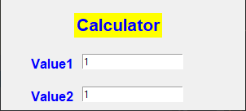

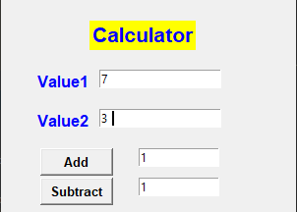
Ex43 (use EX43_skel.py)
Complete add/subtract functionality

Slide 10
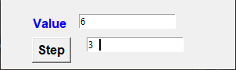

Grid layout
from tkinter import *
window = Tk()
window.geometry("300x300")
window.title("Welcome")
def step():
value1 = int(entry2.get())
value2 = int(entry3.get())
value1 = value1 + value2
entry2.delete(0, END)
entry2.insert(END, value1)
:
button1 = Button(window, text="Step", fg="black",
font=("arial", 12, "bold"), command=step)
button1.place(x=40, y=110)

Slide 11
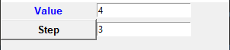
Grid layout (instead of place)
label2 = Label(window, text="Value", fg="blue",width=15, font=("arial", 10, "bold")) #
label2.grid(row=0, column=0, sticky=W+E)
entry2 = Entry(window)
entry2.insert(END, '1')
entry2.grid(row=0, column=1, sticky=W+E)
button1 = Button(window, text="Step", fg="black", font=("arial", 10, "bold"), command=step)
button1.grid(row=1, column=0, sticky=W+E)
entry3 = Entry(window)
entry3.insert(END, '1')
entry3.grid(row=1,column=1, sticky=W+E)

Slide 12
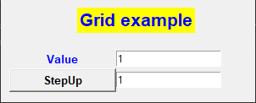
Grid layout (put in an internal frame)
frame = Frame(window, width=200, height=200)
frame.place(x=10,y=80)
label1 = Label(window, text="Grid example", fg="blue",bg="yellow", font=("arial", 16, "bold"))
label1.place(x=90, y=30)
label2 = Label(frame, text="Value", fg="blue",width=15, font=("arial", 10, "bold")) #
label2.grid(row=0, column=0, sticky=W+E)
entry2 = Entry(frame)
entry2.insert(END, '1')
entry2.grid(row=0, column=1, sticky=W+E)
button1 = Button(frame, text="StepUp", fg="black", font=("arial", 10, "bold"), command=step)
button1.grid(row=1, column=0, sticky=W+E)

Slide 13
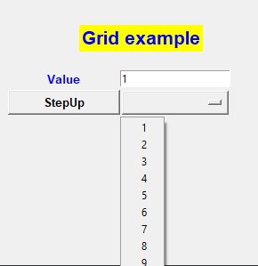
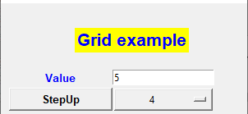
DropBox(replace Entry with combo)
def step():
value1 = int(entry2.get())
value2 = int(stepUpVar.get() )
value1 = value1 + value2
entry2.delete(0, END)
entry2.insert(END, value1)
:
list1=['1','2','3','4','5','6','7','8','9']
stepUpVar = StringVar()
combo1= OptionMenu(frame,stepUpVar, *list1)
stepUpVar.set(“1”) # init value
combo1.grid(row=1,column=1, sticky=W+E)

Slide 14
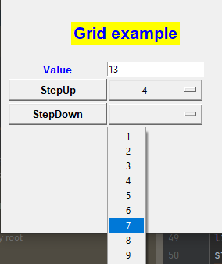
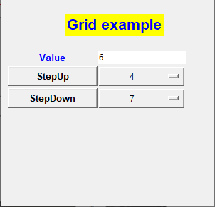
Ex44(Add a Step Down Ex44_skel.py)

Slide 15
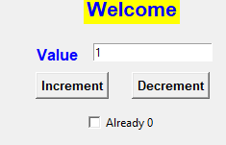
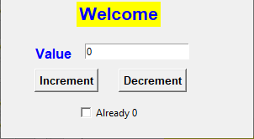

CheckBox
def decr():
value = int(entry2.get())
if (value==0):
cb1.select()
else:
value = value - 1
entry2.delete(0, END)
entry2.insert(END, value)
:
button2 = Button(window, text="Decrement", fg="black",
font=("arial", 10, "bold"), command=decr)
button2.place(x=140, y=110)
var_cb1 = IntVar() # 0 unchecked, 1 checked
cb1 = Checkbutton(window, text="Already 0", variable=var_cb1)
cb1.place(x=90, y=150)
cb1.deselect()

Slide 16
CheckBox
var_cb1 = IntVar() # 0 unchecked, 1 checked
cb1 = Checkbutton(window, text="Already 0", variable=var_cb1)
cb1.place(x=90, y=150)
cb1.deselect() # check
cb1.select() # uncheck
#reading the status
result='unchecked'
if (var_cb1.get()>0): # 1 for checked
result='checked’
print("status={}".format(result))

Slide 17
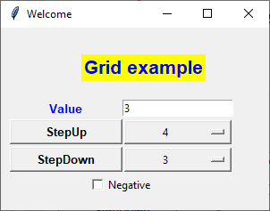
To add a Widget to a grid cover to cover 2 columns
cb1.grid(row=3,column=0,columnspan=2) # instead of place
Row3, Columns 0 & 1

Slide 18
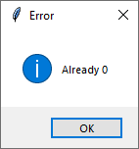
Message Box
from tkinter import messagebox
def decr():
value = int(entry2.get())
if (value==0):
cb1.select()
messagebox.showinfo("Error", "Already 0")
else:
value = value - 1
entry2.delete(0, END)
entry2.insert(END, value)

Slide 19
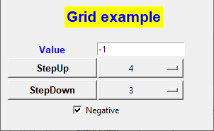

Ex45(Add CheckBox Ex45_skel.py)

Slide 20
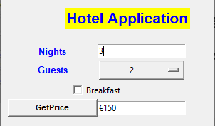
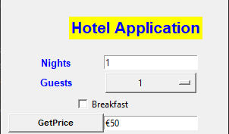
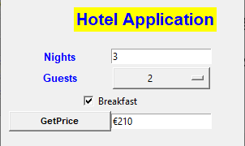
Ex46(Ex46_skel.py) €50 per night (up to 4 guests) Breakfast=€10 per guest per night
Add 3*2*10=60 for breakfast

Slide 21
Additonal Components Can develop nice Basic Gui Using Widgets Entry, Label, Combobox, CheckBox, messageBox And Using grid, place layouts We will briefly show some other options and return to them later

Slide 22
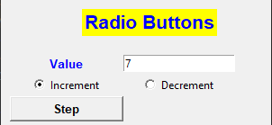


Radio Buttons def step(): value1 = int(entry2.get()) choice = var_radio.get() : var_radio = IntVar() # 1 or 2 r1 = Radiobutton(frame, text="Increment", variable=var_radio, value=1) r1.grid(row=1,column=0) r2 = Radiobutton(frame, text="Decrement", variable=var_radio, value=2) r2.grid(row=1,column=1)

Slide 23
Radio Buttons def step(): value1 = int(entry2.get()) choice = var_radio.get() if (choice==1): value1 = value1 + 1 else: value1 = value1 - 1 entry2.delete(0, END) entry2.insert(END, value1) var_radio = IntVar() # 1 or 2

Slide 24
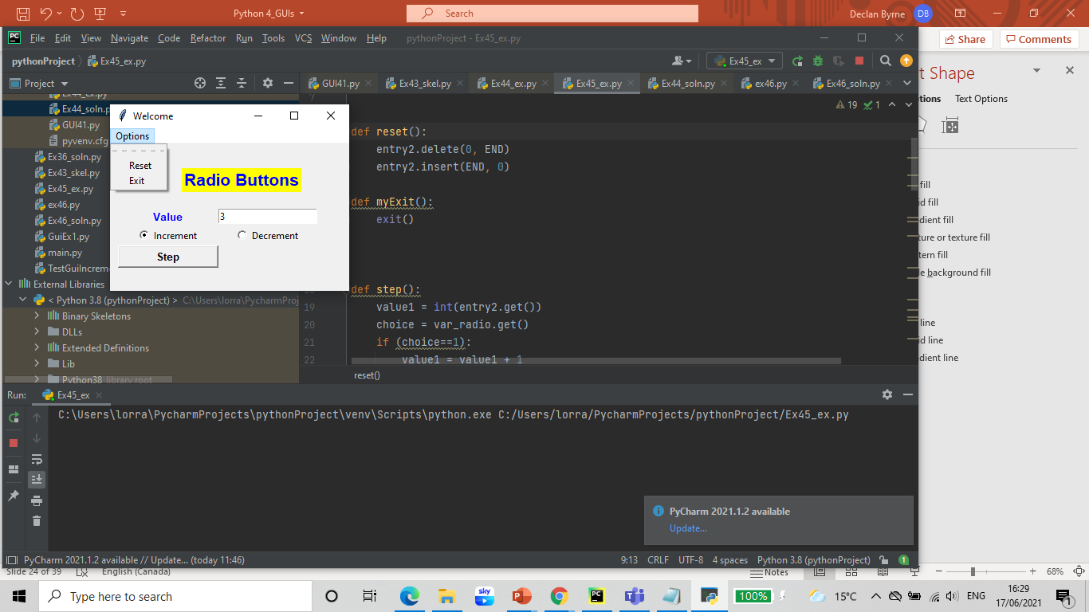
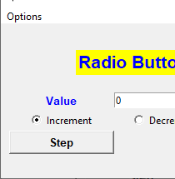
Menus

Slide 25
Menus def reset(): entry2.delete(0, END) entry2.insert(END, 0) def myExit(): exit() menu1 = Menu(window) #MenuBar window.config(menu=menu1) subm1=Menu(menu1) #Menu menu1.add_cascade(label="Options", menu=subm1) subm1.add_command(label="Reset", command = reset) # menu item subm1.add_command(label="Exit", command = myExit)

Slide 26
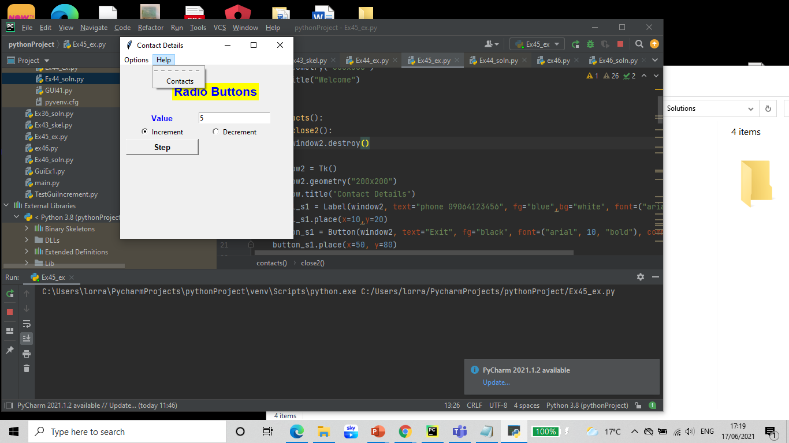
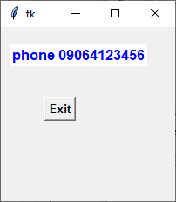
Sub Windows

Slide 27
menu1 = Menu(window) #MenuBar
window.config(menu=menu1)
subm1=Menu(menu1) #Menu
menu1.add_cascade(label="Options", menu=subm1)
subm1.add_command(label="Reset", command = reset)
subm1.add_command(label="Exit", command = myExit)
subm2=Menu(menu1) #Menu
menu1.add_cascade(label="Help", menu=subm2)
subm2.add_command(label="Contacts", command = contacts)

Slide 28
def contacts():
def close2():
window2.destroy()
window2 = Tk()
window2.geometry("200x200")
window2.title("Contact Details")
label_s1 = Label(window2, text="phone 09064123456",
fg="blue",bg="white", font=("arial", 12, "bold"))
label_s1.place(x=10,y=20)
button_s1 = Button(window2, text="Exit",
fg="black", font=("arial", 10, "bold"), command=close2)
button_s1.place(x=50, y=80)

